Slide 1


Human Resource PROJECT PROPOSAL
Presented by: Mohamed Walid, Nourhan Farag, Abdelrahman Yasser, Doha Mostafa, Basant Yasser, Seham Mostafa

Slide 2

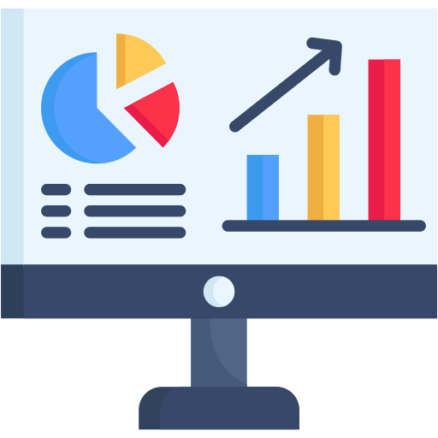
What are we working on?
Data Cleaning Excel, Python
Visualization
Power Bi

Slide 3
About the project

Slide 4
Project Idea
Problem Description: Many HR departments struggle to understand employee behavior, satisfaction levels, and the factors contributing to employee attrition. Making data-driven decisions is often limited due to a lack of clear insights from available employee data.

Slide 5
Project Idea
Proposed Solution: A data analytics project that explores the relationships between employee demographics, work conditions, satisfaction, compensation, and career development. The project will use data analysis and visualization techniques to provide actionable insights for HR decision-makers.

Slide 6
Project Idea
Unique Value Proposition: Unlike generic HR reports, this project integrates multiple employee factors — such as salary, years at the company, overtime, training, and manager relations — to uncover patterns and relationships. It will help organizations improve employee retention and workplace satisfaction through targeted, data-backed strategies.

Slide 7
End Users
HR Managers
Executives
Data Analysts

Slide 8
Interactive Dashboards
Attrition Trend Analysis
Report Export
Features

Slide 9
HR Managers: Identify at-risk employees
Executives: Take data-driven decisions
Analysts: Custom reports easily
How It Solves Their Problems

Slide 10
HR Managers: Identify at-risk employees
Executives: Take data-driven decisions
Analysts: Custom reports easily
How It Solves Their Problems

Slide 11
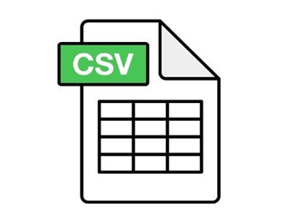
Data source
📂 Data Sources
The dataset used in this project consists of five Excel sheets, each representing a key aspect of employee information:
1. Employee.csv – Contains demographic and job-related details for each employee.
2. EducationLevel.csv – Maps education level IDs to descriptive education categories.
3. PerformanceRating.csv – Includes various performance and satisfaction metrics.
4. SatisfiedLevel.csv – Defines satisfaction levels from “Very Dissatisfied” to “Very Satisfied.”
5. RatingLevel.csv – Translates performance ratings into descriptive categories.
These sheets were cleaned, merged, and analyzed to uncover patterns in employee satisfaction, attrition, and performance.

Slide 12
DATA CLEANING
In the data cleaning phase, we performed five main steps:
1️⃣ Load the Data: "We loaded the employee data from an Excel file into a pandas DataFrame."
2️⃣ Check for Missing Values: "We checked if there were any missing (null) values in the data to make sure every column is complete."
3️⃣ Check for Duplicates: "We searched for duplicate records based on employee information and removed them to avoid bias in analysis."
4️⃣ Check Data Types: "We verified that each column has the correct data type, like integers for age and salary, and strings for names and departments."
5️⃣ Review Data Summary: "Finally, we reviewed the overall structure and summary of the data using .info() and .head() to confirm it’s clean and ready for analysis."

Slide 13
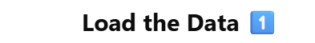

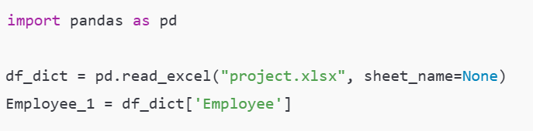
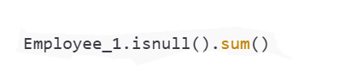
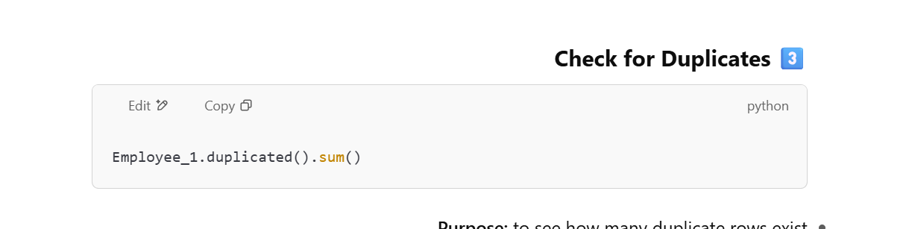
DATA CLEANING

Slide 14
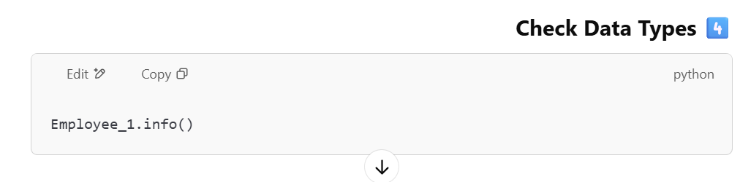

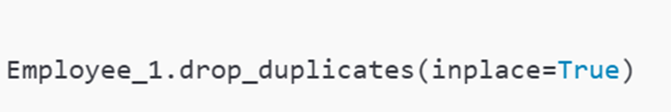
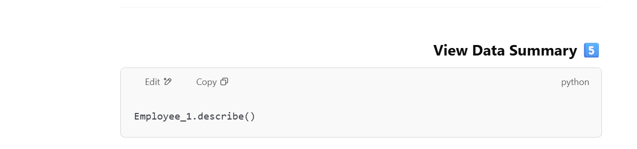

Slide 15
Questions Phase
1.Ethnicity by Employees.
2. What is the average number of training opportunities taken in each department ?
3. Count Employees by Job Role .
4. How does the level of education affect salary?
5. Attrition Rate by Education Level.
6. Attrition rate by Marital status .
7. Average Salary by Department.
8. the correlation between years at the company, years in the most recent role, years since last promotion, and years with the current manager.
9. Distribution of Education Field.
10. Distribution of Marital Satu

Slide 16
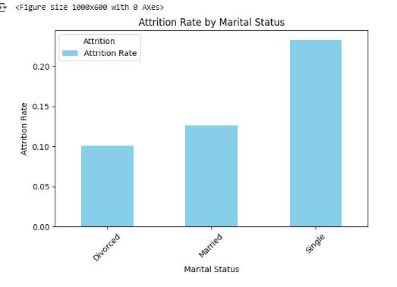
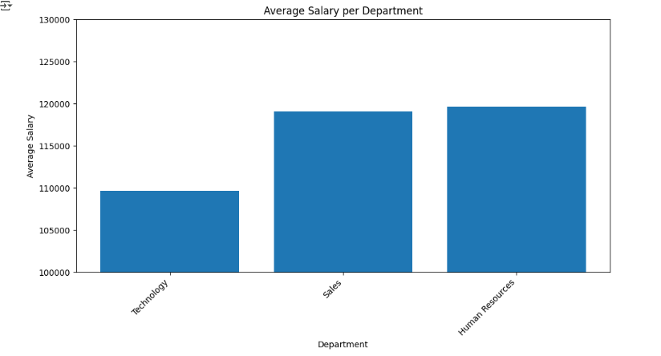
Questions Phase
Python Sheet
Pandas, Numpy, Maltplotible, Jupyter Notebook

Slide 17
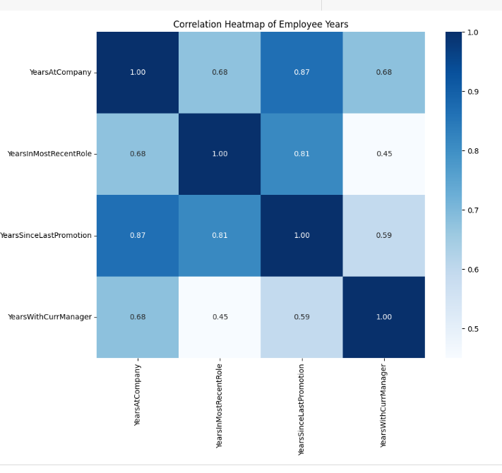
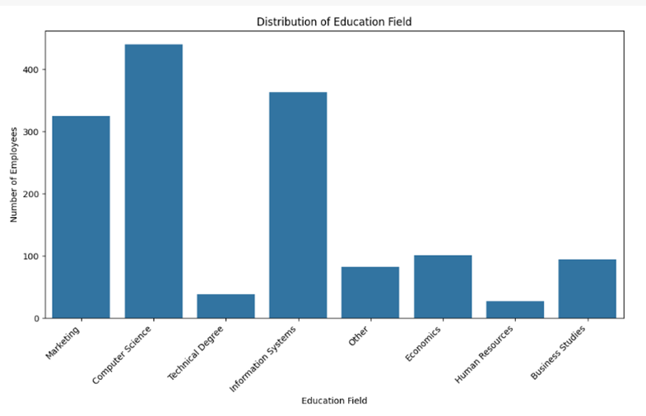
Questions Phase
Python Sheet
Pandas, Numpy, Maltplotible, Jupyter Notebook

Slide 18
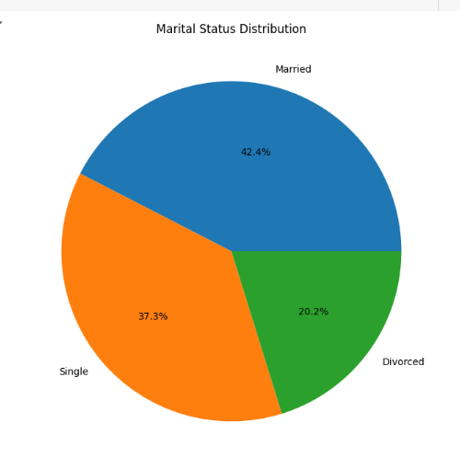
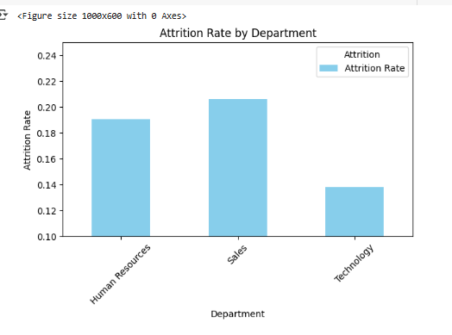
Questions Phase
Python Sheet
Pandas, Numpy, Maltplotible, Jupyter Notebook

Slide 19
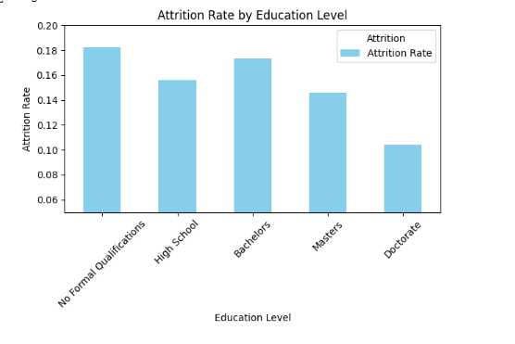
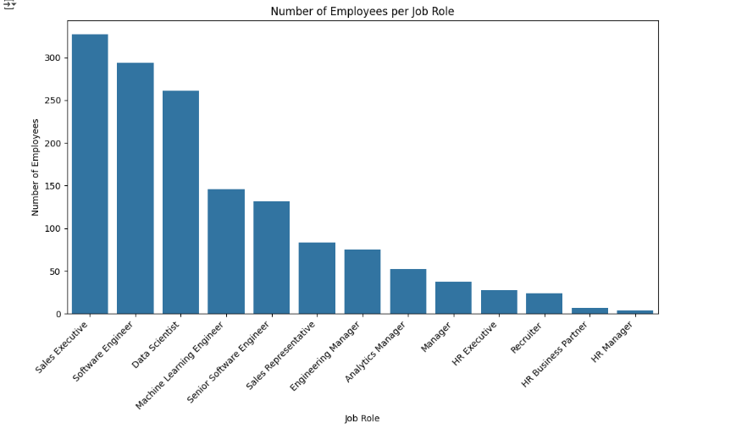
Questions Phase
Python Sheet
Pandas, Numpy, Maltplotible, Jupyter Notebook

Slide 20
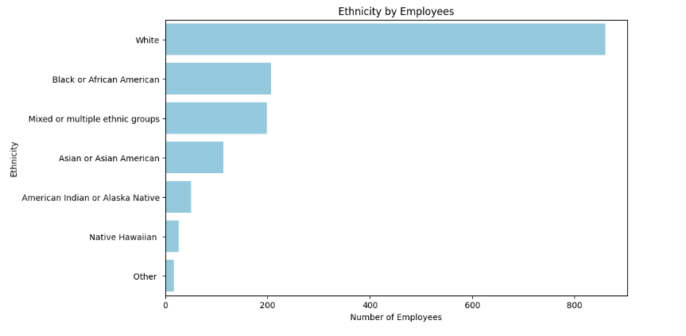
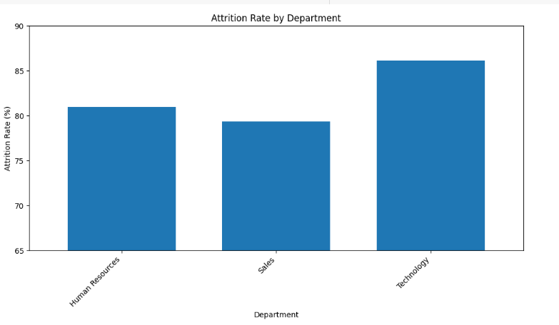
Questions Phase
Python Sheet
Pandas, Numpy, Maltplotible, Jupyter Notebook

Slide 21
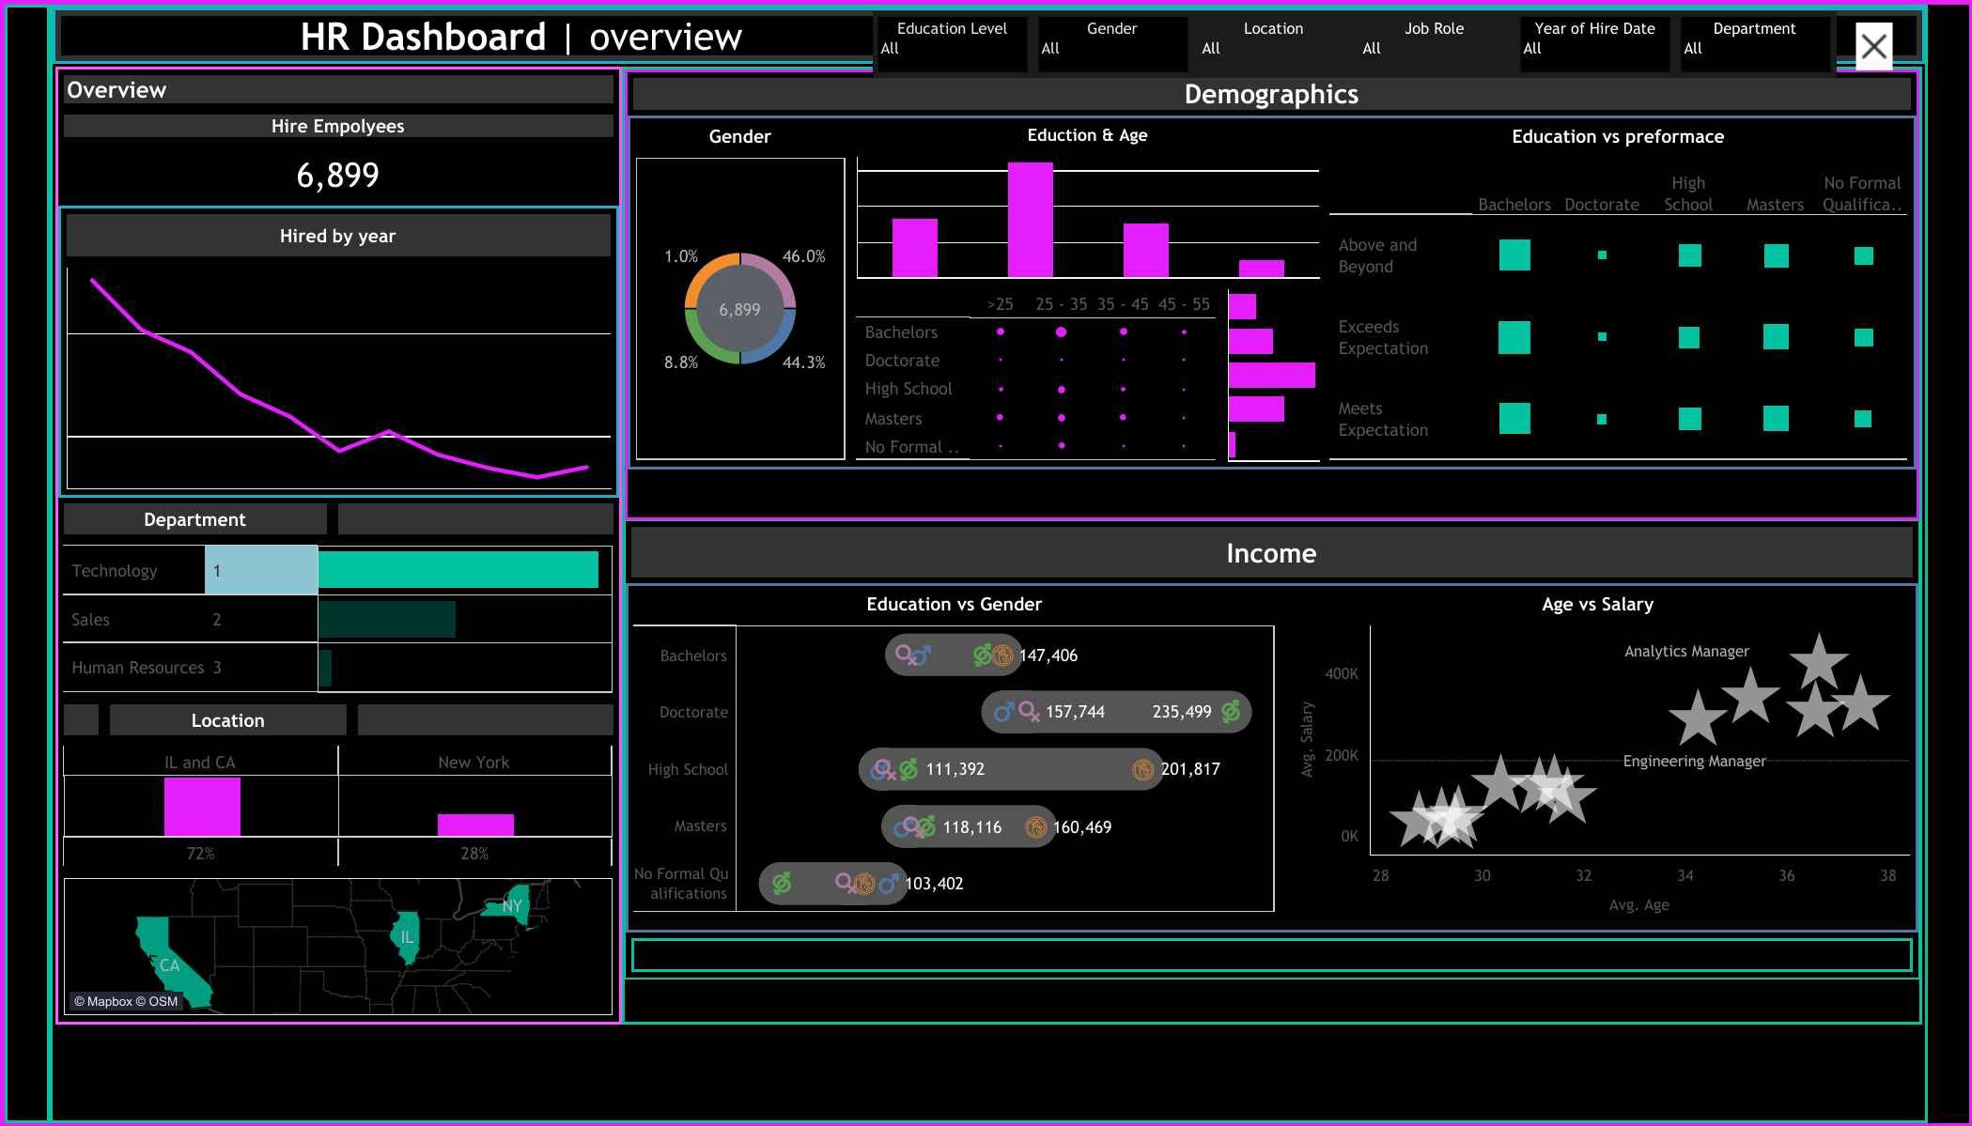
Questions Phase
Dashboard Tableau

Slide 22

Programming Languages + Frameworks
Programming Language:
Python (Used for data analysis, data cleaning, and visualization)
Frameworks & Tools:
Pandas – for data manipulation
Matplotlib / Seaborn – for data visualization
Plotly – for interactive charts
Jupyter Notebook – for developing and presenting the analysis interactively
Supporting Technologies:
Excel / CSV files – for importing/exporting data
Google Colab – as a cloud-based development environment )https://colab.research.google.com/drive/16TPSVlAKZNGvpMvw9rnO9ppJ_kDyi71I?usp=sharing(
GitHub – for version control and collaboration ()

Slide 23

Live Application
Overview of the Current State:
The project is currently in the analysis and reporting phase (no deployed live application).
Interactive visualizations were created using Plotly and Seaborn.

Slide 24
Test
Key Testing Phases:
Data Validation: Ensuring accuracy and consistency in datasets.
Visualization Testing: Reviewed by peers and mentor for clarity and correctness.
User Feedback: Preliminary feedback indicates visuals are clear and insightful.

Slide 25
Project deliverables
Deliverable 1
o Cleaned dataset ready for analysis.
o Data preprocessing notebook.
Deliverable 2
o Set of analysis questions that can be answered via the dataset.

Slide 26

Team Role
Member Name | Role | Responsibilities
Mohamed Waled | Data Analyst, Visualization Specialist | Data cleaning, EDA, visualization
Nourhan Farag | Visualization Specialist, Data Analyst | Creating graphs using Seaborn/Plotly
Basant Yasser | Documentation Lead, Visualization Specialist. | Preparing report and presentation, , visualization
Doha Mostafa | Visualization Specialist, Data Analyst | EDA, Visualization
Seham Mostafa | Data Analyst, Visualization Specialist | EDA, Data Cleaning
Abdelrahman Yasser | Documentation Lead, Data Analyst. | Visualization, preparing report

Slide 27

Thank You !

